Slide 1

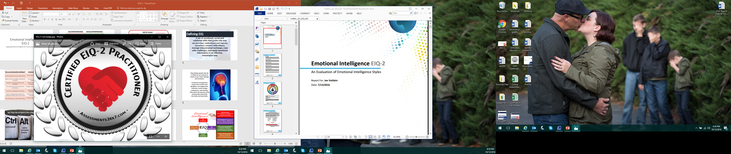
Emotional Intelligence EIQ-2
Applying Emotional Intelligence for Personal and Professional Success
Notes:
Welcome to Emotional Intelligence.
Many people are familiar with the idea and use of Emotional Intelligence, and it is becoming an increasingly popular hot topic in the world and workplace. The purpose of our time together is to introduce a foundation of understanding for Emotional Intelligence, and create a simple, practical and applicable opportunity to examine our strengths and challenges and determine appropriate courses of action to get our personal and professional results through relationships that we desire.

Slide 2

Introductions
Please introduce yourself:
Name & Title
What do you know about EIQ already?
What are you hoping to gain from this session?
Notes:
Review Slide

Slide 3
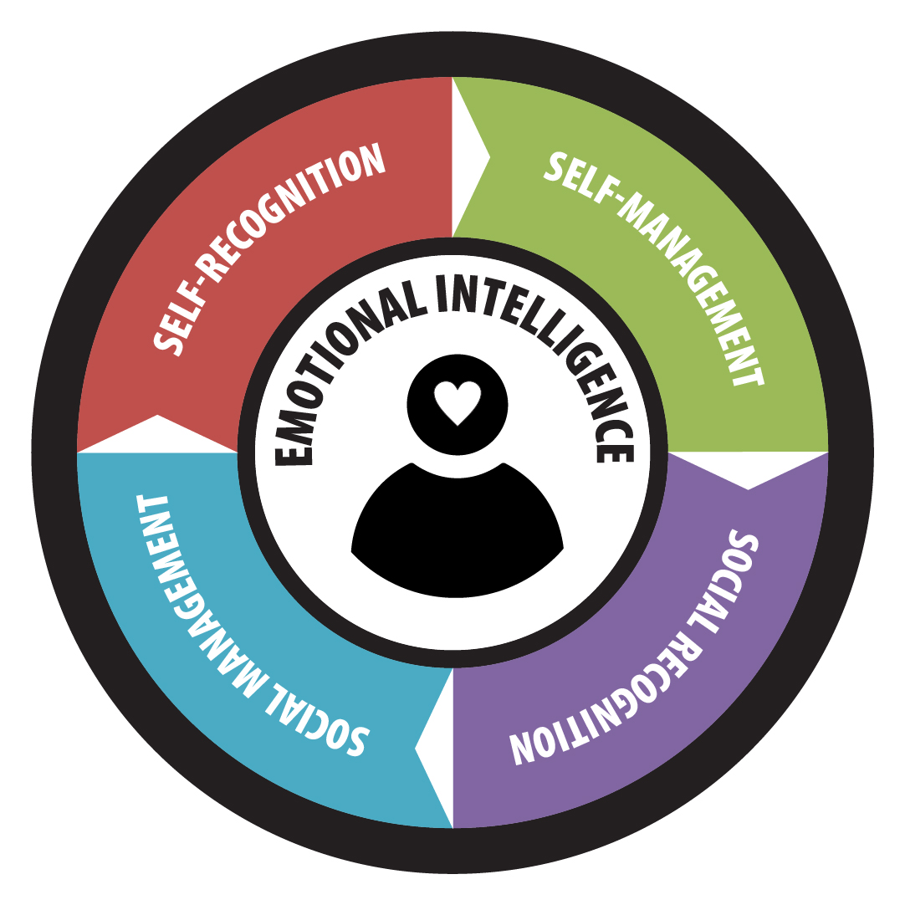
Emotional Intelligence
The ability to:
perceive emotions
access and generate emotions to assist thought
understand emotions and emotional knowledge
reflectively regulate emotions to promote emotional and intellectual growth
Emotional Intelligence is a way of recognizing, understanding and choosing how we think, feel and act, shaping our understanding of ourselves and our interactions with others.
Notes:
Emotional intelligence focuses on self and relationships. Intrapersonal awareness and management deal with recognizing, acknowledging and working with emotions. Interpersonal relationships deal with empathy, connection and social skills. These are known as soft skills but tend to be more meaningful in performance.
EIQ is all about recognizing our emotions and how they impact others, and recognizing others’ emotions and appropriately responding in a way that builds effective relationship.
In this assessment, keep in mind that this is a snapshot of a moment in time, and emotional intelligence can shift.
Furthermore, each of these areas are connected. While it starts with Self-recognition and moves through management, then social recognition to management, each of these areas are related to one another and have impact on one another. If you don’t understand yourself well, how can you manage you? If you don’t recognize what’s happening with others, how do you appropriately respond in relationship. The key is knowing the impact of your own EIQ on self and others and how to work with it appropriately and effectively.

Slide 4
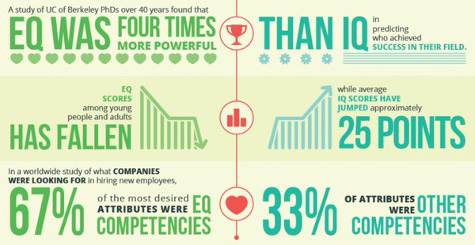
Why Does it Matter?
Notes:
Based on this information, EQ is an influential contributor to personal and professional success and yet there is a lack of support for learning and growth in this area.

Slide 5
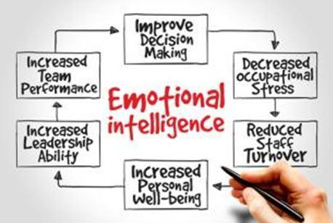
EIQ can be measured as difference directly associated with personal and professional success in many areas, including:
Communication
Decision-Making
Leadership
Sales
Teamwork & Team Performance
Productivity
Relationship Satisfaction
Customer Service
Conflict Management
Overall Effectiveness
Why Does it Matter?
Notes:
Furthermore, there are so many benefits to having a strong EIQ.
Review Slide.
ASK: What would good emotional intelligence look like in one of these areas? Give an example

Slide 6
Optional Discussion
Communication
Decision-Making
Leadership
Sales
Teamwork & Team Performance
Productivity
Relationship Satisfaction
Customer Service
Conflict Management
Overall Effectiveness
As a table group:
Define success in 3 of the areas based on your current understanding of emotional intelligence.
Notes:
What does success look like in each of these areas, when emotional intelligence is High?

Slide 7
Low Emotional Intelligence | High Emotional Intelligence
Feels misunderstood and unappreciated | Learns and adapts to audiences and situations
Blames others for problems and difficult situations | Assumes responsibility and fixes problems (creatively)
Subject to emotional outbursts and moodiness | Takes control of performance and productivity; Self-disciplined
Gets angry and hostile in conflict and confrontation | Manages feelings for positive, win/win resolution
Focuses on competition and winning | Emphasizes abundance thinking, teamwork and collaboration
Doesn’t understand what others are thinking and feeling unless directly told | Effective at reading both verbal and nonverbal cues for empathy
Has few long-term, quality relationships | Leverages relationships for mutual gain and growth
Notes:
High/Low Emotional Intelligence
Quick tips on high and low emotional intelligence.

Slide 8
Reflection
Individually:
Consider areas of your life that reflect high or low emotional intelligence. What is currently happening that makes you think so?
Notes:
What is my emotional intelligence and how is that affecting me right now?

Slide 9
Self Intra-Personal
Social Inter-Personal
Self Recognition
Self-confidence
Awareness of emotional state
Recognizing cause and effect in emotion
Paying attention to changes in emotional states
Social Recognition
Empathy
Picking up the moods of others
Caring what others are going through
Reading both verbal and nonverbal signals
Recognition
Self Management
Creating goals and direction
Discipline and self-control
Being trustworthy
Flexibility and adaptability
Optimism
Motivation and Initiative
Sustaining quality relationships
Handling conflict effectively
Leadership and influence
Collaboration, cooperation and teamwork
Effective interaction
Social Management
Management
Notes:
The Emotional Intelligence Index reviews four (4) basic areas. Within each competency, there is an overall score. The Index is predicated on the abilities to recognize, understand and manage emotions (intrapersonal communication); and the ability to recognize, empathize, and relate to others (interpersonal communication). The Emotional Intelligence Index evaluates several aspects of your emotional intelligence and suggests ways to improve it.

Slide 10
Discussion
As a group:
What is the most important quotient measured in Emotional Intelligence and why?
Notes:
This can be done two ways:
assign each of the 4 quotients to groups, and have that group outline and defend why their quotient is the most important
OR
2. As the whole group to debate/discuss which of the 4 is most important?

Slide 11
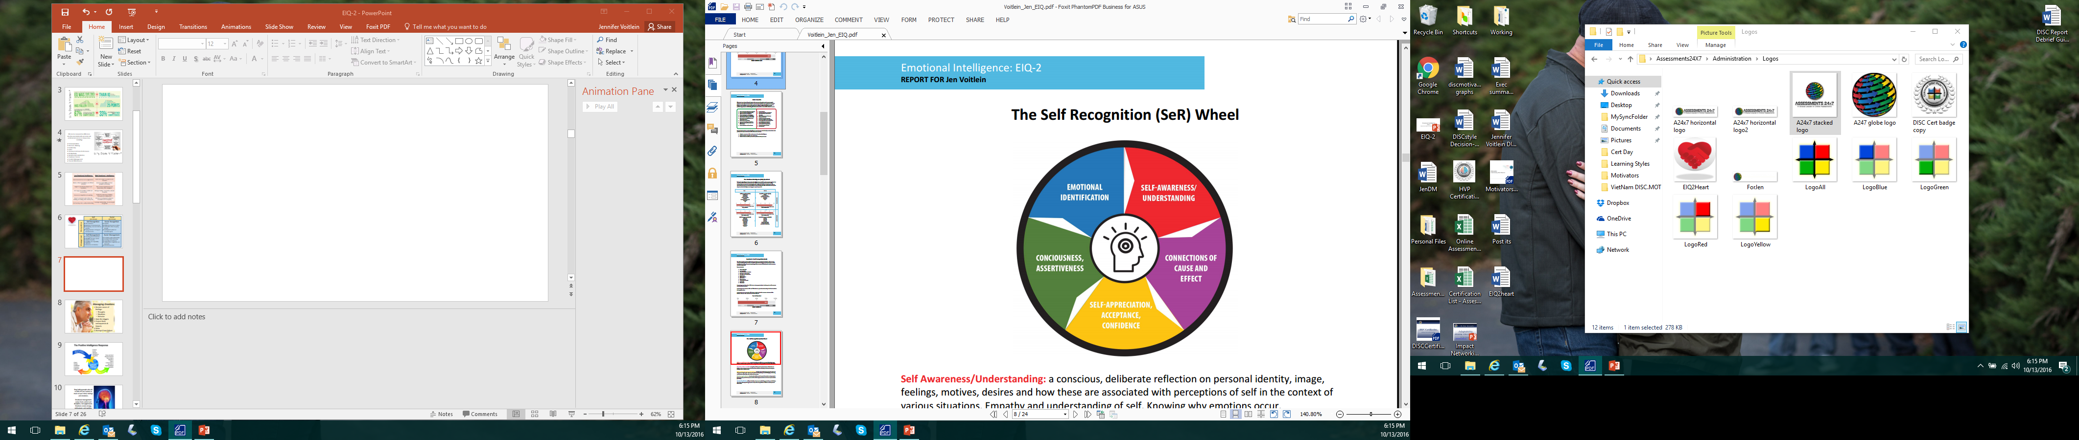
Self Recognition
Self Awareness/ Understanding
Connection of Cause and Effect
Self Appreciation, Acceptance and Confidence
Consciousness, Assertiveness
Emotional Identification
Self-recognition reflects intrapersonal communication. It is foundational to social awareness and self-management.
Notes:
Factors include: Personality style, learning style, mental attitude, comfort and discomfort, strengths and weaknesses, biofeedback, self-acceptance, self-esteem, temperament, tension and stress levels, spirituality and conscience.
Self Awareness/Understanding: a conscious, deliberate reflection on personal identity, image, feelings, motives, desires and how these are associated with perceptions of self in the context of various situations. Empathy and understanding of self. Knowing why emotions occur.
Connections of Cause and Effect: recognition of the impact and consequence of behaviors on feelings and moods; separating external and internal factors effecting emotions. Knowing how feelings relate to performance.
Self Appreciation, Acceptance and Confidence: development of self esteem; personal worth and value; and coming to grips with personal attributes. Recognizing personal strengths, weaknesses, and limitations. Operating with realistic self assurance.
Consciousness, Assertiveness: intentional establishment of personal boundaries and appropriate limits; choosing a path that expresses self worth through personal care and outward presentation
(presence).
Emotional Identification: ability to identify and name personal feelings; vocabulary and definition of emotions allowing choices, responses and performance; effective reflection on intrapersonal information.

Slide 12
Building Self-Recognition
Accept emotions without judgment.
Self monitor; take time to reflect and review.
Associate emotions with attitudes and consequences.
Accept advice without becoming defensive.
Develop greater mental security - feeling safe and comfortable with who you are regardless of outside challenges and threats.
Analyze strengths and weaknesses fairly and with an eye toward growth.
Create realistic personal expectations.
Cultivate positive mindset and optimism.
Connect with positive, supportive people.
Generate expectations of causes and consequences.
Notes:
Review Slide.
Highlight the one or 2 ideas that resonate with you and remember to come back to review how to incorporate these into your action plan.
Ask: What can stand in the way of building this quotient?

Slide 13
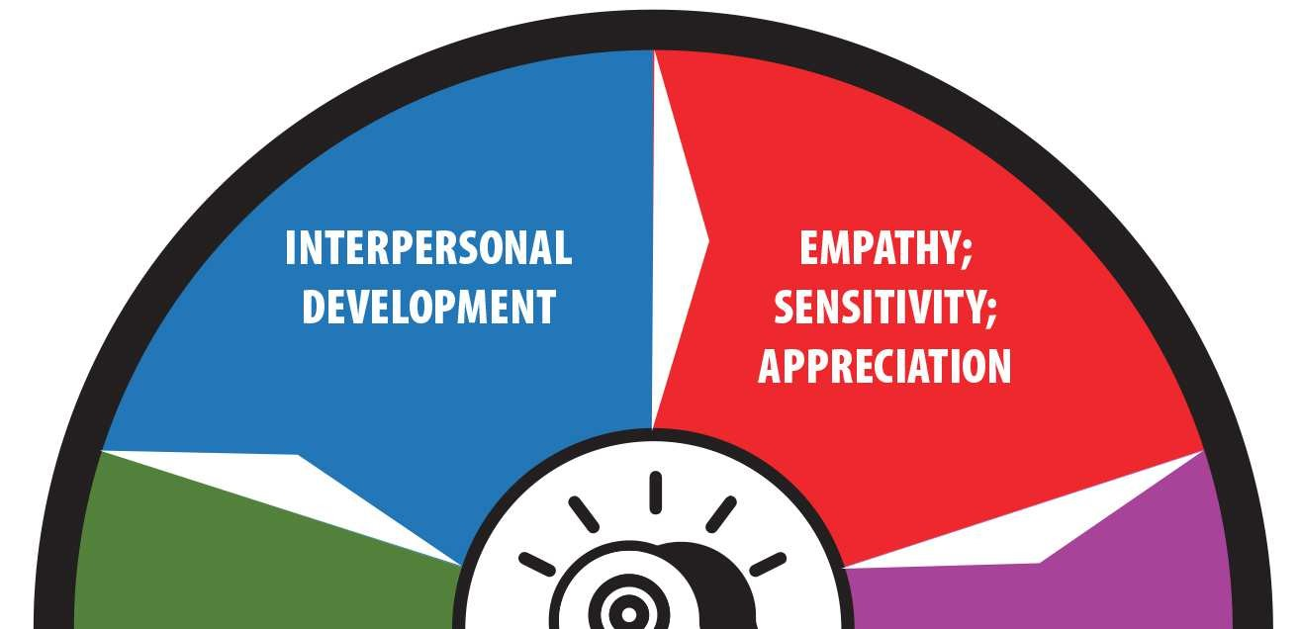
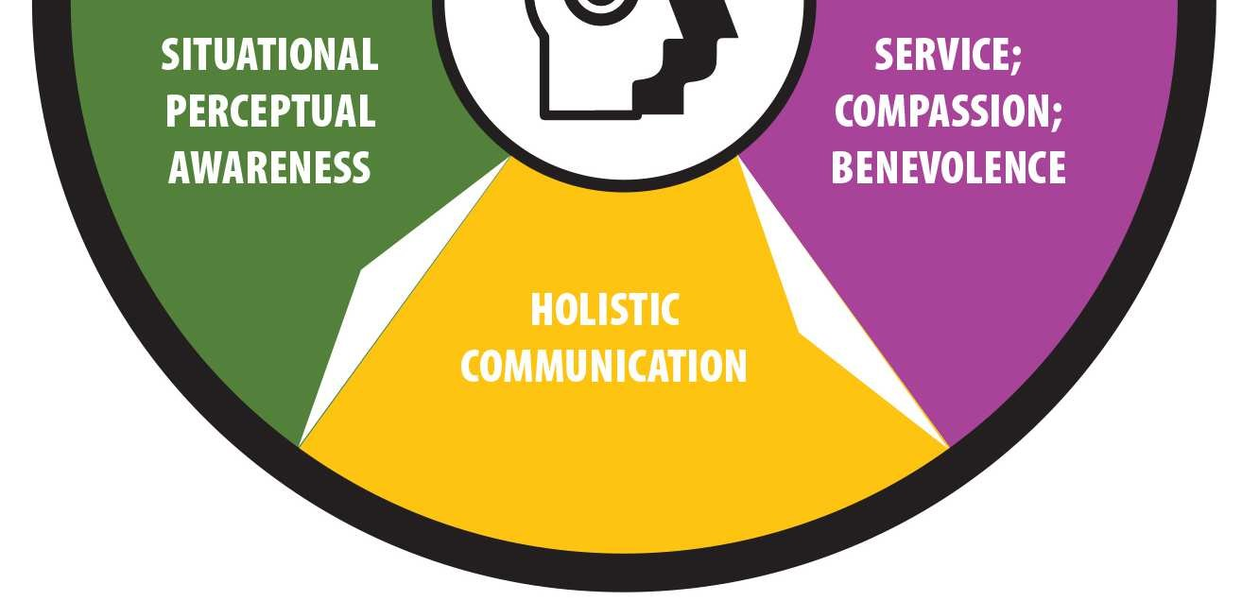
Social Recognition
Empathy, sensitivity, appreciation
Service, compassion, benevolence
Holistic Communication
Situational Perceptual Awareness
Interpersonal Development
Social-recognition reflects awareness and consideration of the feelings and responses of others. The ability to empathize and maintain sensitivity to the moods and emotions of others allows for superior connection.
Notes:
Factors included: Empathy, Understanding/compassion, Sensitivity/thoughtfulness, Appreciation, Holistic communication, Rapport, Connection and
Relationships
Empathy; Sensitivity; Appreciation: understanding others; accurately picking up emotional cues from communication (including words, tone and nonverbal signals); managing direct and indirect feedback effectively; being attentive, sensitive, aware and appreciative of the emotional signals of others.
Service; Compassion; Benevolence: operating with a sense of contribution; aiding, helping, coaching and developing others; giving; operating constructively to contribute to the emotional states and benefits of others; recognizing needs, wants and desires; relating to alternative thoughts, perceptions and perspectives.
Holistic Communication: the abilities to effectively send and receive information including emotional content; listening; engaging and connecting with others; sending and receiving verbal and nonverbal signals constructively.
Situational Perceptual Awareness: recognizing and processing dynamic, shifting emotional data; communicating attention, focus, awareness and connection; adapting to situational variables and changes; understanding which factors count, how much and responding with reasonable behavior.
Interpersonal Development: growing and nurturing constructive connections; setting the tone for long term depth and breadth in relationships; working with quality in personal and professional relations; having resonance and rapport.

Slide 14
Building Social-Recognition
Actively look for opportunities to help others and promote their agendas.
Actively listen; pay attention.
Take in feedback and critique from others.
Become more interested and enthusiastic about others.
Follow through on promises and commitments.
Create opportunities to connect.
Be positive and open when responding to new people and ideas.
Pay attention to both head and heart messages.
Notes:
Review Slide.
Highlight the one or 2 ideas that resonate with you and remember to come back to review how to incorporate these into your action plan.
Ask: What can stand in the way of building this quotient?

Slide 15
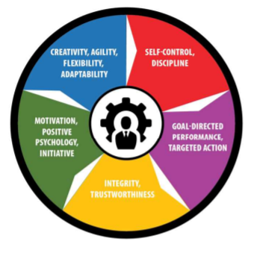
Self Management
Self-control, discipline
Goal-directed performance, targeted action
Integrity, trustworthiness
Motivation, positive psychology, initiative
Creativity, agility, flexibility, adaptability
Self-management measures self-evaluation coupled with self-regulation, to control and harness feelings that impact the ability to achieve personal objectives.
Notes:
Factors include: Restraint, Discipline, Control, Resolve, Direction/purpose, Emotional management, Flexibility, Enthusiasm/excitement
Satisfaction, happiness and contentment are results of self management.
Self Control; Discipline: effectively handling impulses; maintaining composure while experiencing stressful, trying emotions; managing preparation and performance; actively choosing paths; self directing; the ability to emotionally persist to achieve strategic objectives.
Goal Directed Performance; Targeted Action: focus to achieve long term desired goals; emotional tenacity and persistence; drive to choose challenging objectives and assume acceptable risk; staying the course to completion; resilience in the face of obstacles and setbacks; seizing opportunities.
Integrity; Trustworthiness: the ability to work with conscience, ethics and integrity; operating with personal standards, principles and values; being dependable, reliable and authentic; keeping promises and assuming personal responsibility.
Motivation, Positive Psychology; Initiative: self energizing; the ability to be mentally and emotionally engaged; attitude; passion; choosing cause and effect feelings; being responsible for personal success; acting and choosing feelings in accordance with positive emotions, optimism and constructive feelings; limiting negative emotions, patterns and spirals.
Creativity, Agility, Flexibility; Adaptability: coping with change, transition and development; adjusting to situations, relationships and feelings; handling curiosity and imagination to create, discover and explore opportunities; innovation for progress; cognitive and emotional shifts to augment and manage change; the abilities to problem solve and 'think outside the box.'

Slide 16
Building Self-Management
Set and monitor a specific course and path for each day.
Act with focus and intensity.
Define a clear path to desired goals.
Exercise discipline and self control in both short and long term projects.
Take time to evaluate and critique personal performance.
Identify gaps in desired returns and improve plans to achieve better results.
Avoid fatigue and burnout.
Stick with a concrete, articulated agenda.
Remain accountable for your actions.
Notes:
Review Slide.
Highlight the one or 2 ideas that resonate with you and remember to come back to review how to incorporate these into your action plan.
Ask: What can stand in the way of building this quotient?

Slide 17
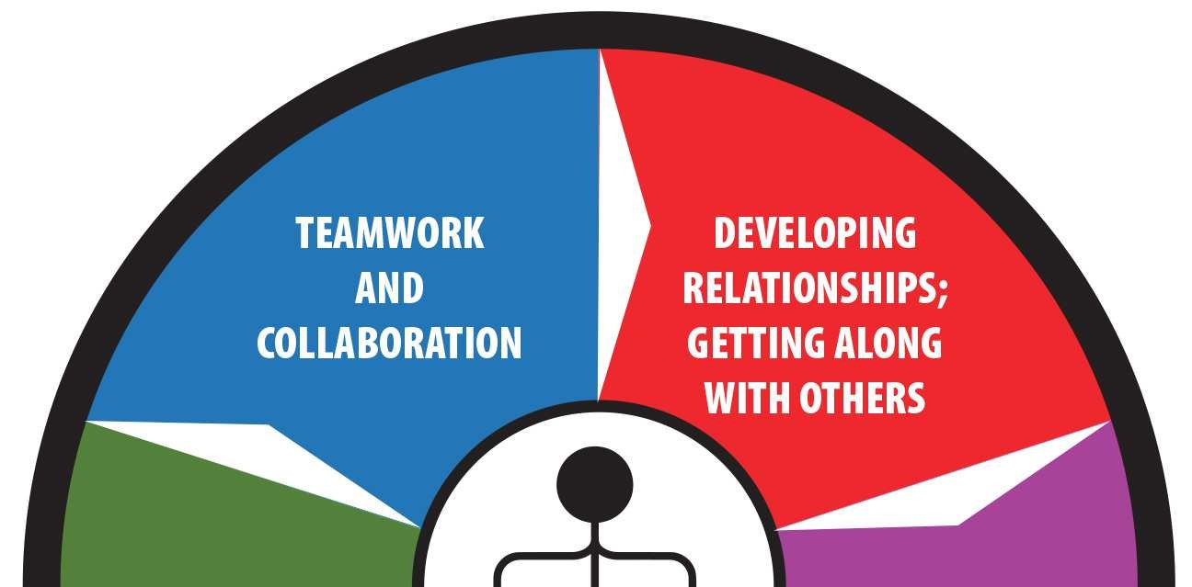
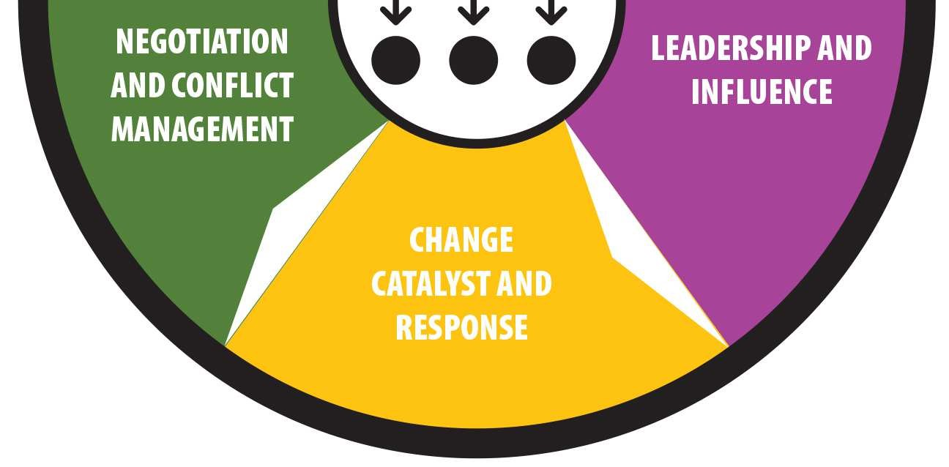
Social Management
Developing relationships, getting along with others
Leadership and influence
Change catalyst and response
Negotiation and conflict management
Teamwork and collaboration
Social (relationship) management includes interpersonal skills and focuses intelligence on generating results. Social intelligence fosters collaboration and connection.
Notes:
Factors include: Directing, Encouragement, Building friendships, Supporting, Social poise, Warmth, Team results, Collaboration
Developing Relationships; Getting Along with Others: cultivating, nurturing and maintaining long term personal and professional relationships; having quality connections and friendships.
Leadership and Influence: operating with warmth, likability, presence, charisma, and approachability; paying attention and focusing on results; being involved, engaging, passionate and powerful; showing deliberate persuasion; delivering solutions and success to others and to groups; partnering for targeted outcomes.
Change Catalyst and Response: recognizing the need for change and championing action; develop interpersonal skills and abilities; initiating growth and progress on individual, team and organizational levels; facilitating maturity and success. Focusing on eustress and positive outcomes.
Negotiation and Conflict Management: bargains with abundance thinking for mutual gains; copes with conflict through positive proactive and reactive techniques; effectively deals with difficult people and situations; creates unity, balance and gain.
Teamwork and Collaboration: builds bonds; transforms groups into teams; fosters unified, engaged effort; generates collaboration, cooperation, participation and high quality results; nurtures spirit de corps and the ability to develop synergy. Interpersonal emotional effectiveness.

Slide 18
Building Social-Management
Take an active interest in others and their agendas.
Develop persuasion and rapport.
Be assertive, engaged, enthusiastic and involved with others.
Maintain poise and calmness.
Look for positive, constructive answers that help everyone improve.
Seek out opportunities to work and collaborate with others.
Reach out and be available to others.
Enjoy listening to the ambitions of others and offer praise.
Develop quality relationships and friendships.
Notes:
Review Slide.
Highlight the one or 2 ideas that resonate with you and remember to come back to review how to incorporate these into your action plan.
Ask: What can stand in the way of building this quotient?

Slide 19
Important
The quotients do not stand alone. Each influences the others, so if one changes and increases or decreases, you are likely to see a change in the other quotients as well.
Notes:
Review slide.
It is important to remember that putting work into increasing any quotient of EIQ can affect other areas as well. Since they are all connected, making changes to one or more quotients can carry over!

Slide 20
BREAK

Slide 21

Emotional Intelligence
Application
Ask the Right Questions
Manage Emotions
Emotional Self-Coaching
Notes:
While it’s great to look at where we currently are, what are some things we can do to strengthen our emotional intelligence?

Slide 22
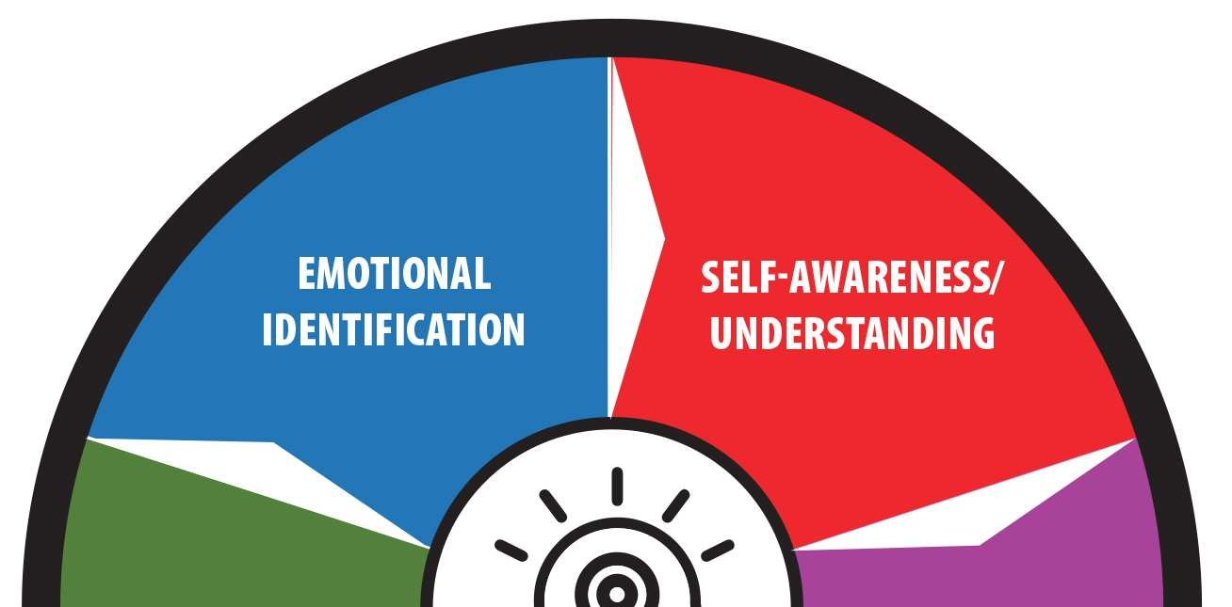
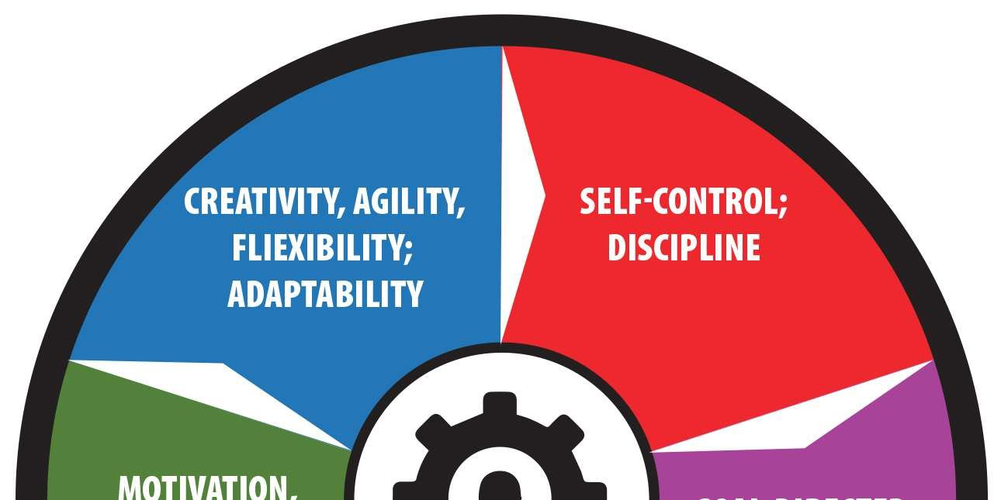
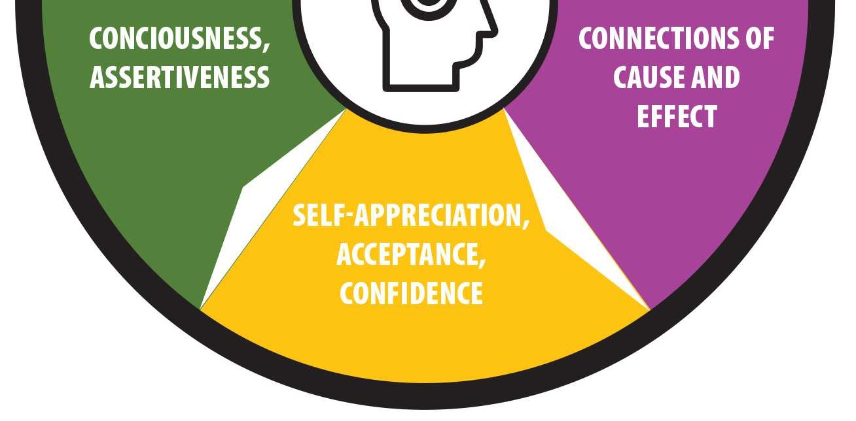
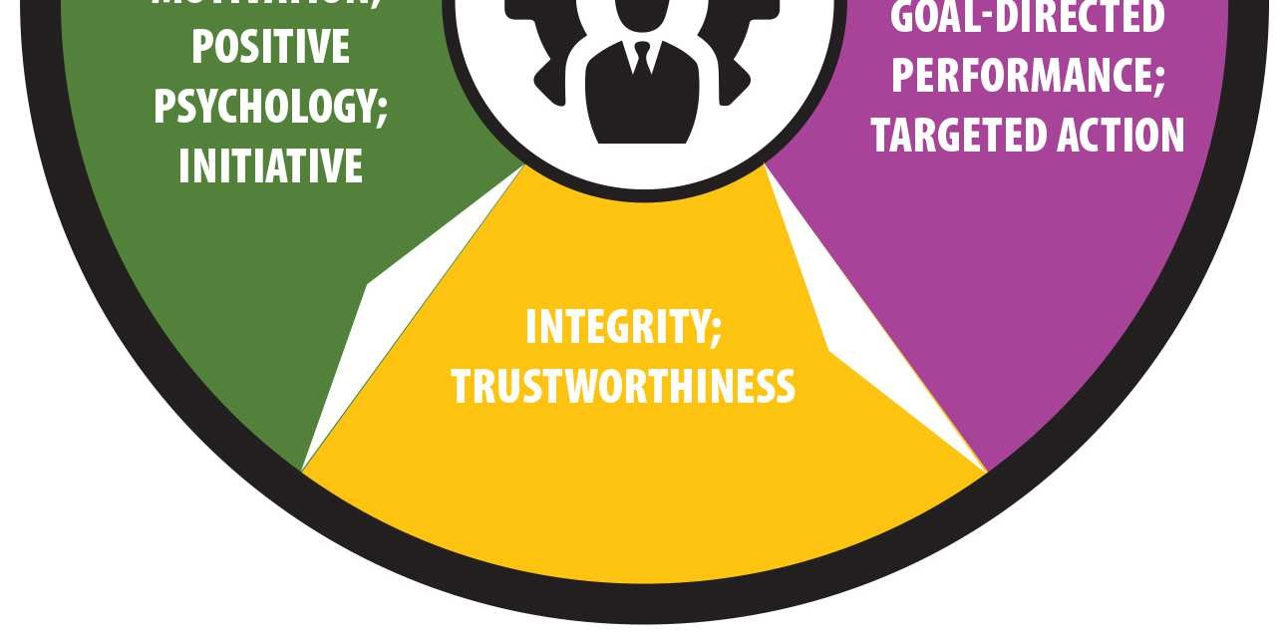
Activity: Ask the Right Questions
Self Recognition
Who am I?
Social Recognition
Self Management
What are my priorities and goals?
How can I best manage my time, talent and resources?
Social Management
What is my purpose?
Where do I get my confidence, self-esteem, self-worth?
What makes me happy?
What can I do to serve and bring value?
What messages am I sharing (verbal/non-verbal)?
What are my key conversations (with whom, regarding what)?
How can I improve myself, my abilities, my value?
How can I promote abundance and mutual gain?
What can I do to add quality and strengthen relationships?
How can I share compassion, kindness, caring and consideration?
Notes:
Choose 1 from each category and really answer it…. Give reflection time.

Slide 23
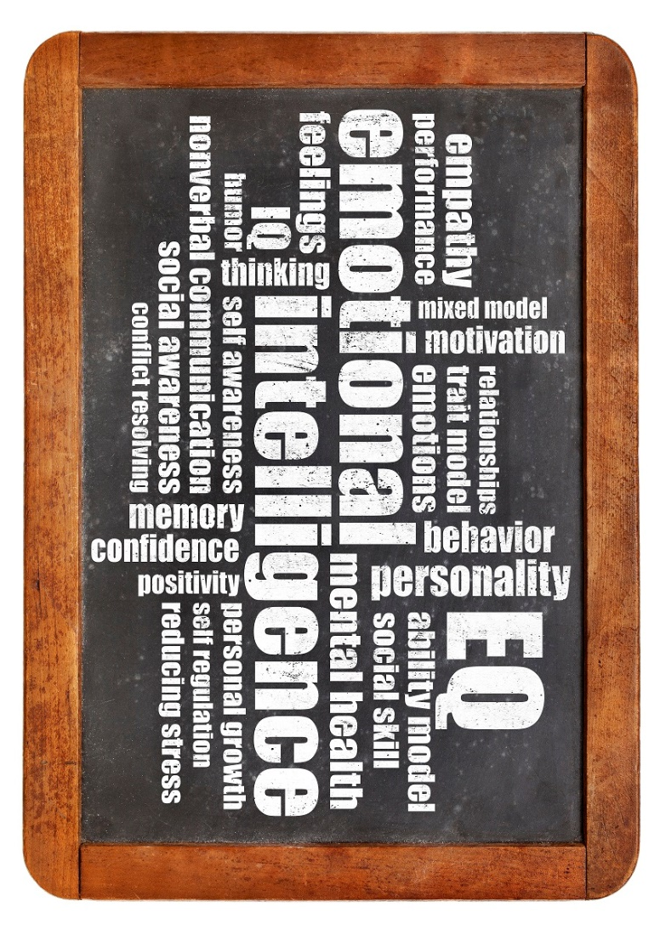
Managing Emotions
Become aware of:
Thoughts
Emotions
Behavior
Note the triggers
Project likely consequences & impacts
Relax
Manage/Cope/Adjust
Notes:
Become Self-Aware and Manage Emotions
Managing feelings comes through awareness , noting cause and effect, and taking appropriate action to respond rather than react.
Think of the last time you had a negative emotional response. What happened? What thoughts, emotions and behaviors did you experience? What triggered your emotional response?
By actively examining past patterns, you can pro-actively prepare for future emotions also.
Consider: Your company just gave you some feedback that client was not happy with your service and would not be returning as a customer. Using the 5 steps, work through how to proactively respond to manage your emotions effectively.
To help with manage/cope/adjust, we suggest Self-Coaching as a tool.

Slide 24
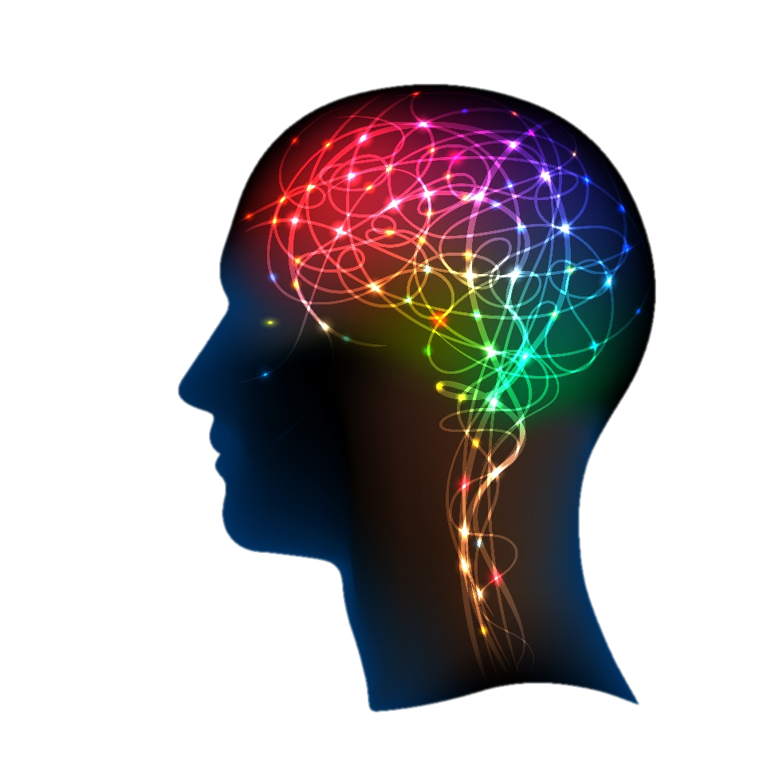
Observe
Pause
Direct
Action
Reflect
Celebrate
Perceive
Emotional Intelligence
Self-Coaching
Notes:
Self-Coach
Improvement happens when deliberate coaching and mentoring impact performance and results. Self-coaching begins by choosing areas to monitor and improve. Begin with observe.
Observation provides continual feedback.
Perceptions allow for information to be processed and form improvement.
A considered pause allows thought to catch up.
Directing action and change comes from intentional focus.
Reflection evaluates and analyzes.
Celebration reinforces, conditions and shapes growth.
Consider the previous example: Your company just gave you some feedback that client was not happy with your service and would not be returning as a customer. Now that you’ve worked through managing emotions, how would you use the above to self-coach. Work together as a group to come up with some questions/considerations for each area.

Slide 25
Emotional Intelligence EIQ-2
An Evaluation of Emotional Intelligence Styles Report Debrief

Slide 26
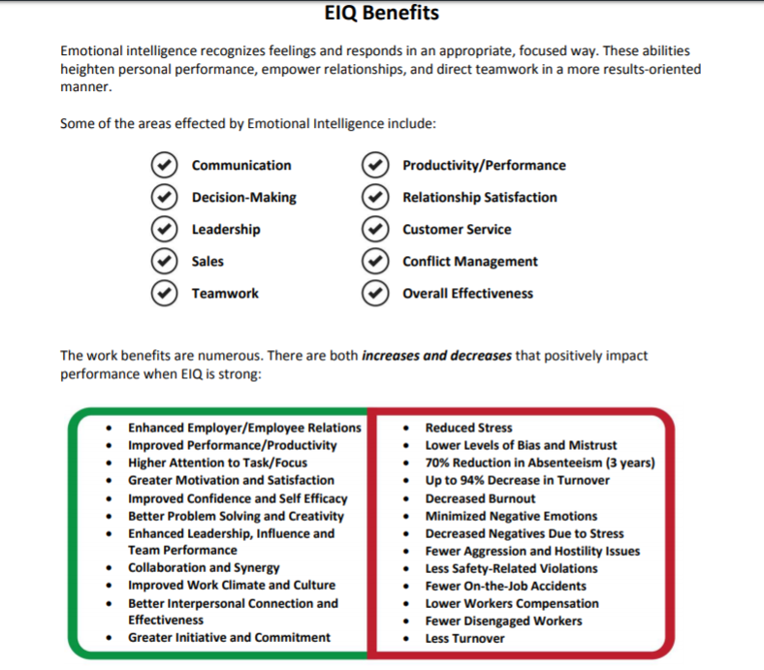
EIQ Report Debrief
Begin with the benefits page:
Areas affected by EIQ
Positive impacts (increases and decreases

Slide 27
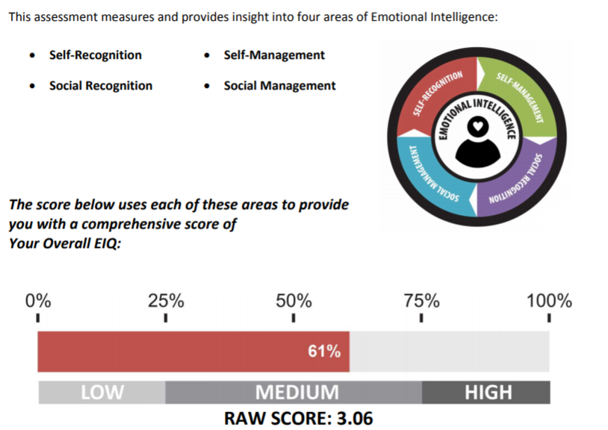
EIQ Report Debrief
Overall Definitions and Scoring
Four Quotients All areas related Begins with Self-Recognition
Overall EIQ Score Percentage Low-Med-High Raw Score on scale of 1-5

Slide 28
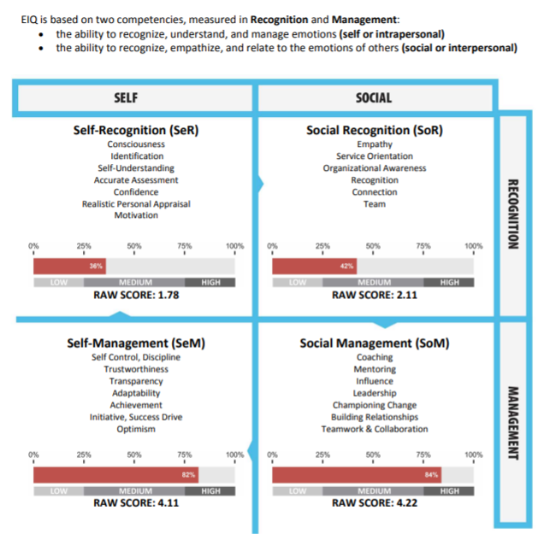
EIQ Report Debrief
Four Quotient Scores
Review patterns
Capability
Focus

Slide 29
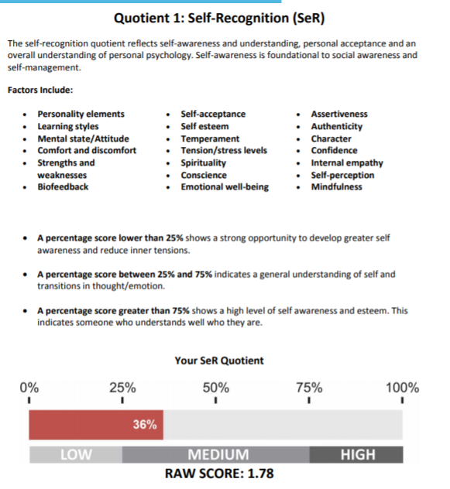
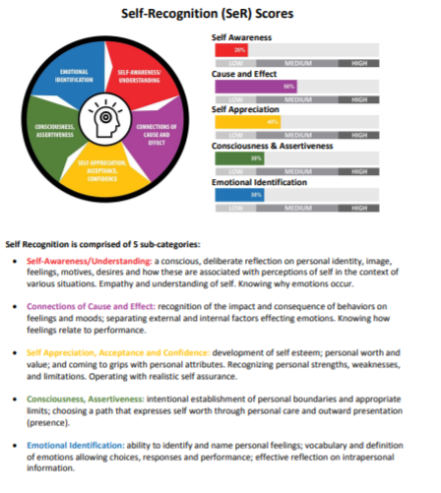
Individual Quotient Sections
Summary
Sub-Scores

Slide 30
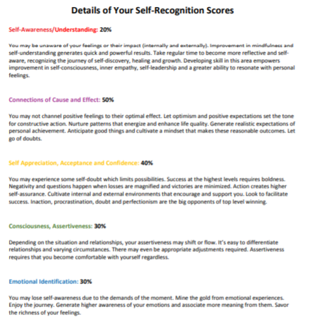
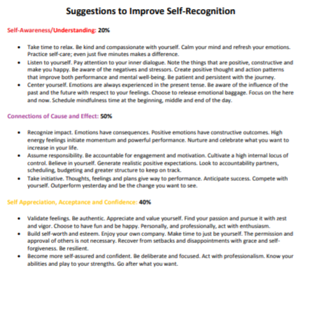
Individual Quotient Sections
Details
Suggestions

Slide 31
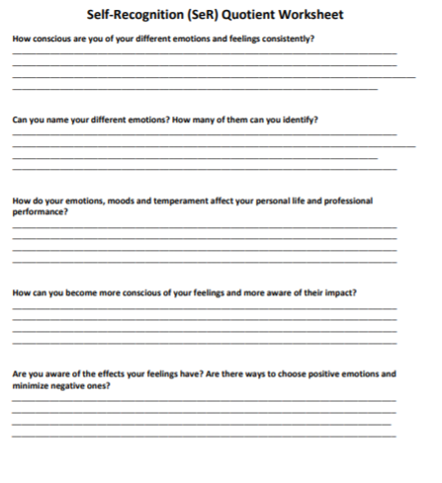
Individual Quotient Sections
Each Quotient has the same details:
Introduction Page with Scores
Sub-Scores and Definitions
Specific Personalized Statements
Suggestions for Improvement
Quotient Worksheet
Worksheet

Slide 32
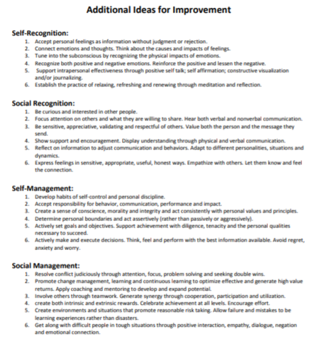
EIQ Report Debrief
Additional Ideas for Improvement by whole quotient

Slide 33
Remember
Building emotional intelligence takes practice!
Take it one day at a time, and focus on small changes that you can sustain to strengthen your EIQ.
You will see changes, though they may be gradual. Stick with it, and know that your learning and practice is a continual growth process.
Notes:
Building emotional intelligence takes practice. Competence breeds confidence, which leads to inner motivation.
The key to making EQ easier to master is to break the improvement suggestions into simple bite-size pieces that can be readily digested and successfully implemented in your life.
The speed with which you apply your new EQ knowledge should change your behaviors gradually, not radically, so that it affects your life permanently - not as quick fixes learned today, forgotten tomorrow. Training, learning and practicing must become an all the time behavior.

